Slide 1
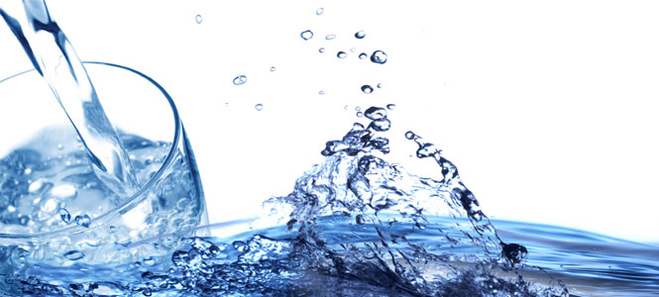

SHARE THE WATER

Slide 2
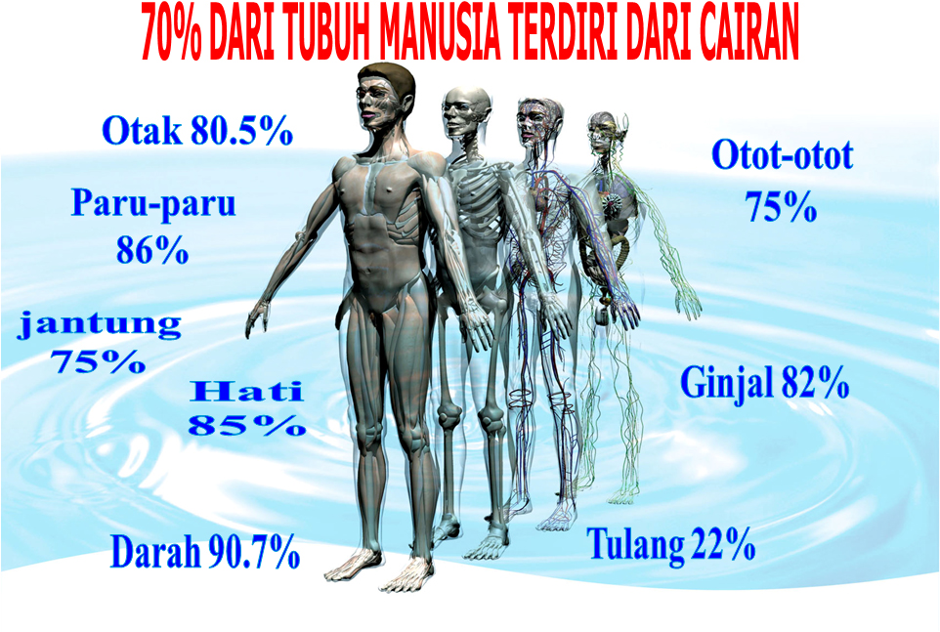

Slide 3
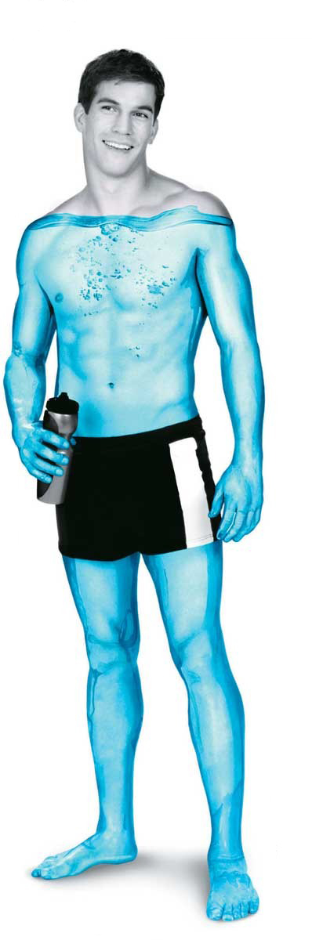
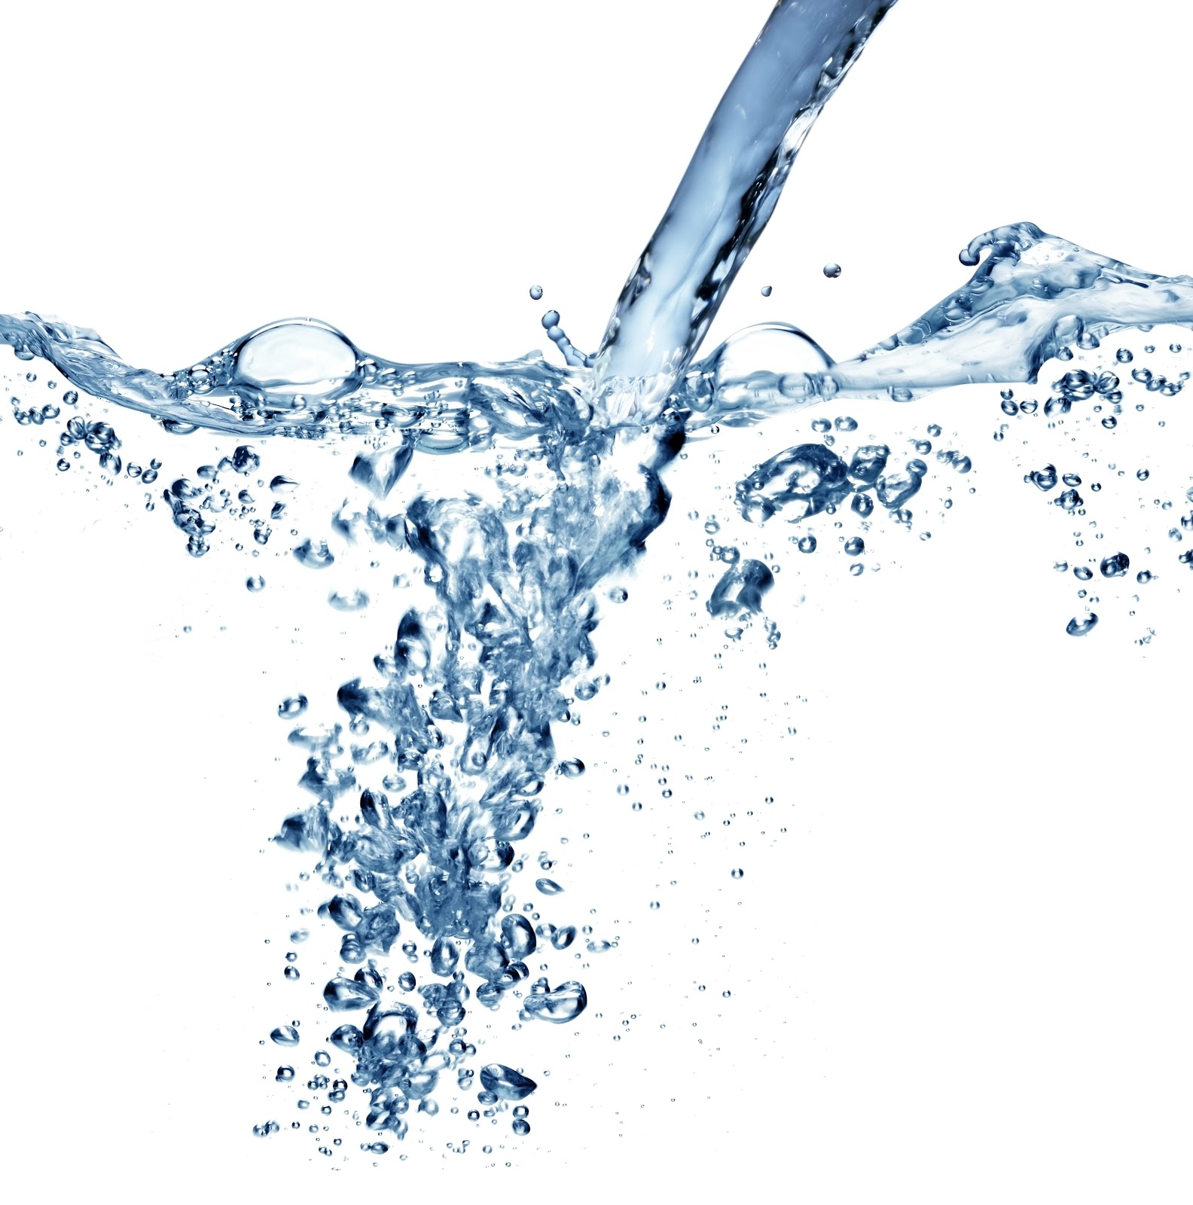
Sudahkah anda mengkonsumsi air
yang sehat ?
Bagaimana dengan kualitas air
yang anda konsumsi sekarang ?

Slide 4
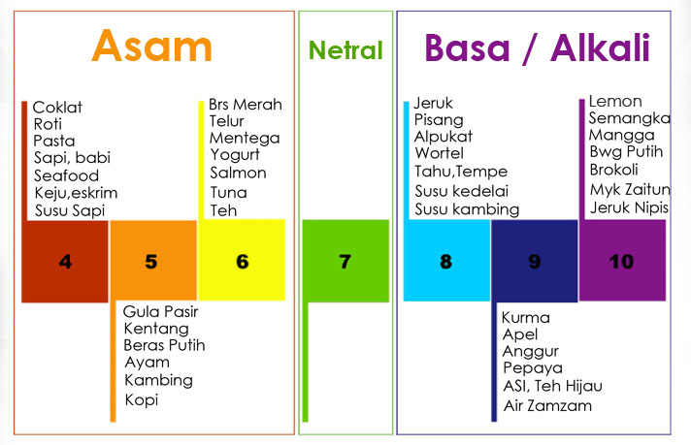
80% makanan & minuman kita bersifat ASAM

Slide 5
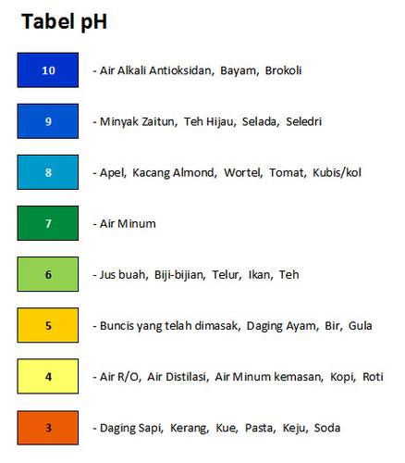
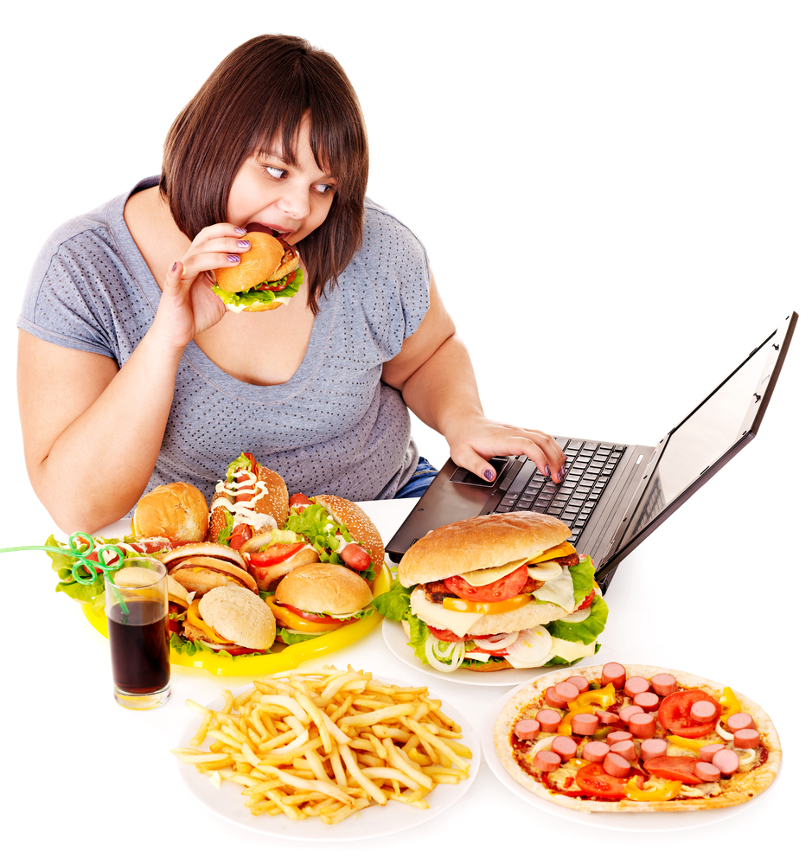

Slide 6
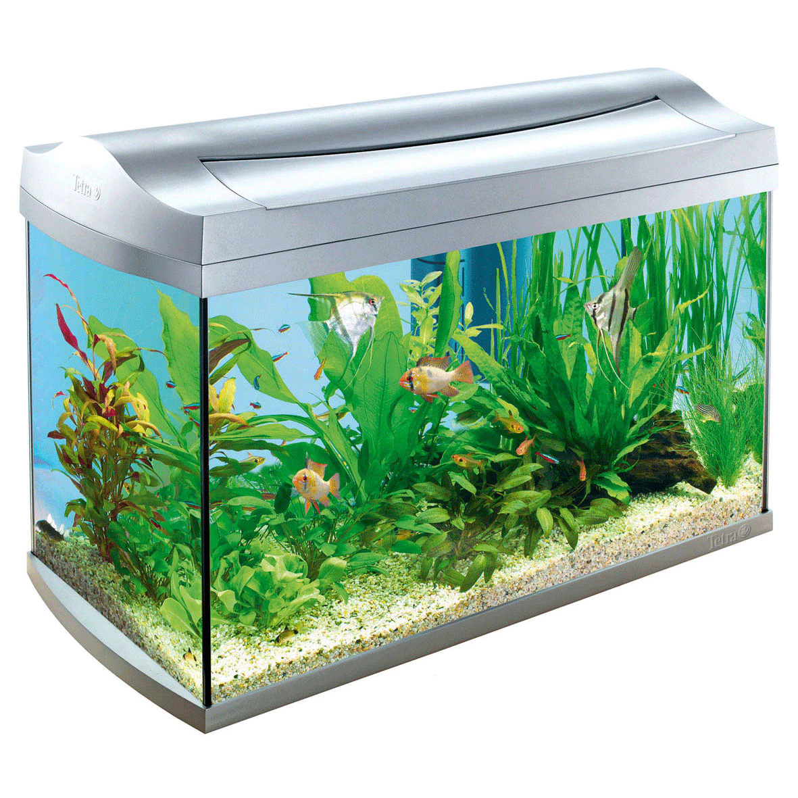
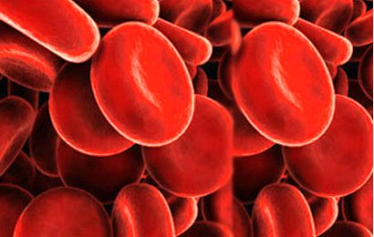
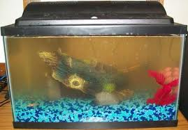
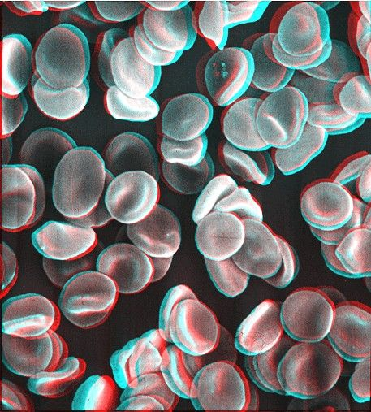
Per 60 detik 300.000.000 sel dalam tubuh mati
Sel Tubuh Manusia Seperti Ikan dalam Akuarium
ACID OVERLOAD

Slide 7

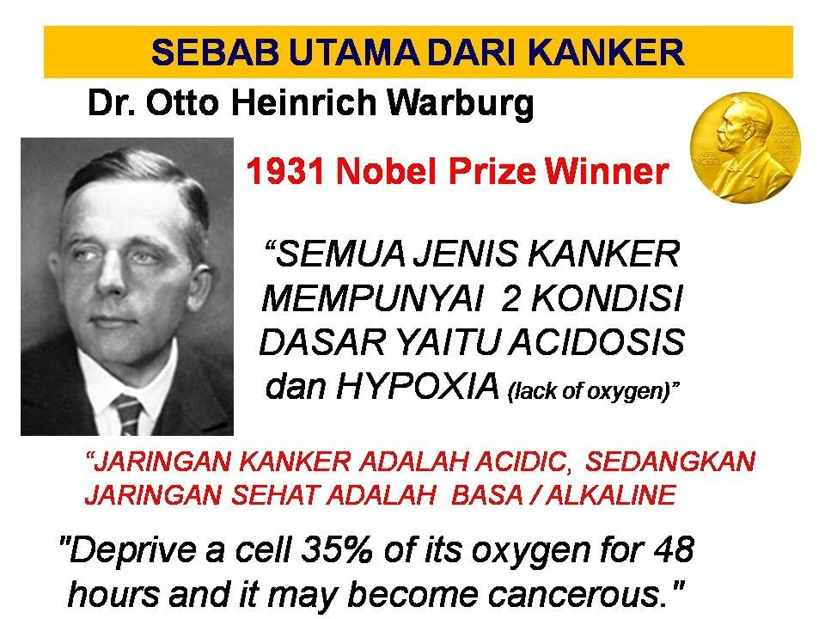
7

Slide 8
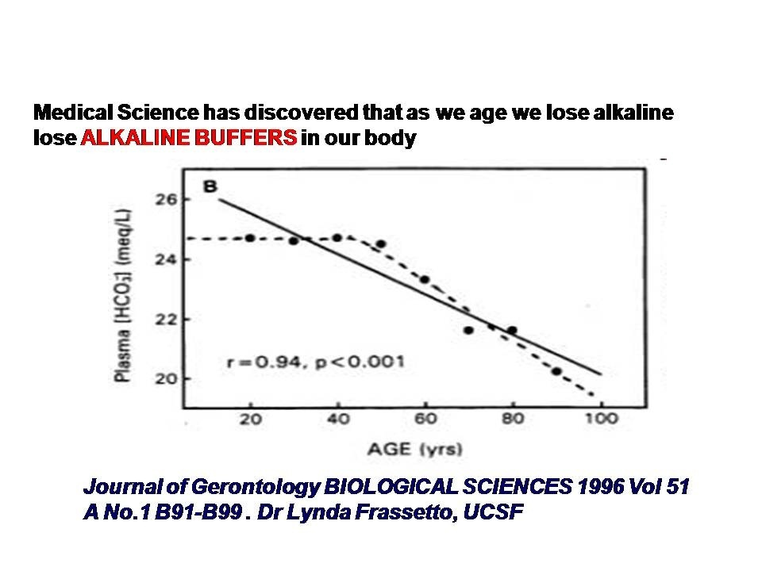

Slide 9
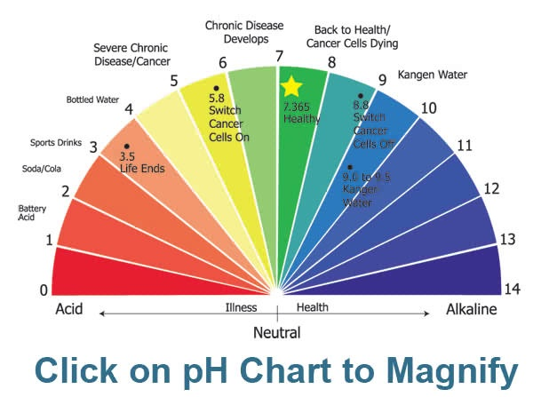

Slide 10
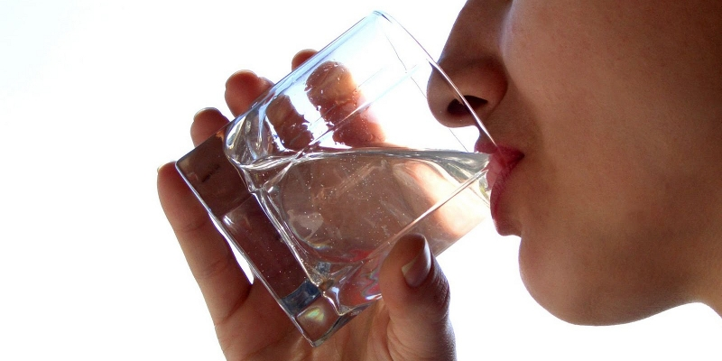
Kita Butuh Air yang Sehat
Alkalyze
Micro Cluster
Anti Oxidant

Slide 11
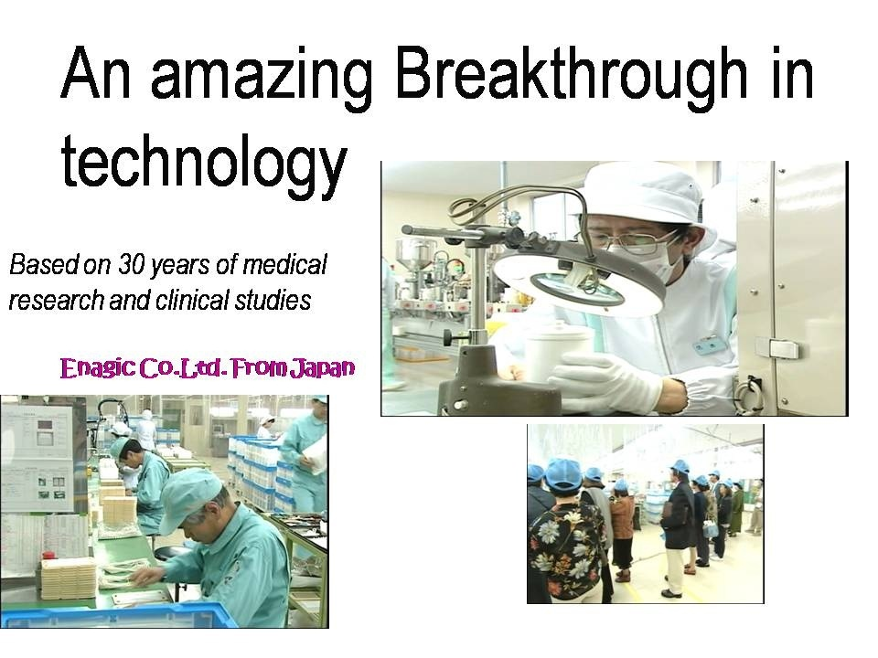
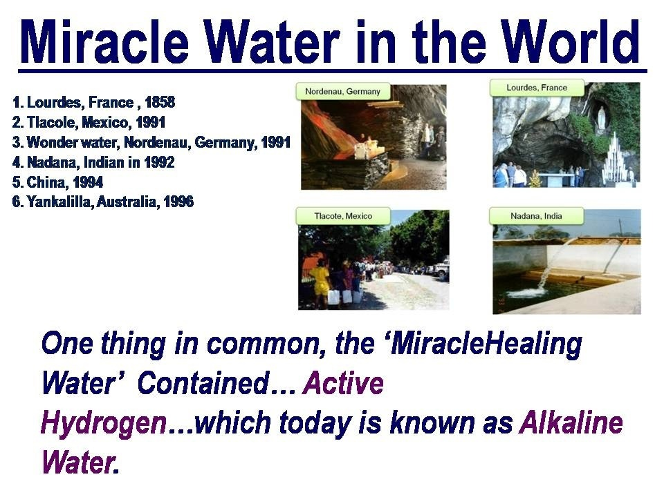

Slide 12


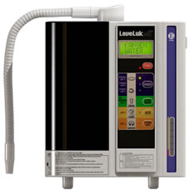


Slide 13
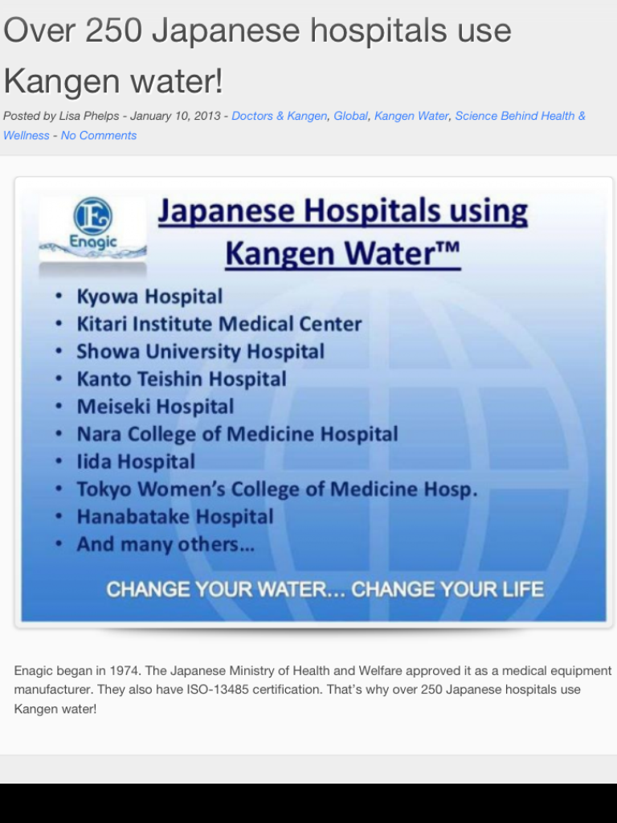

Slide 14


Slide 15
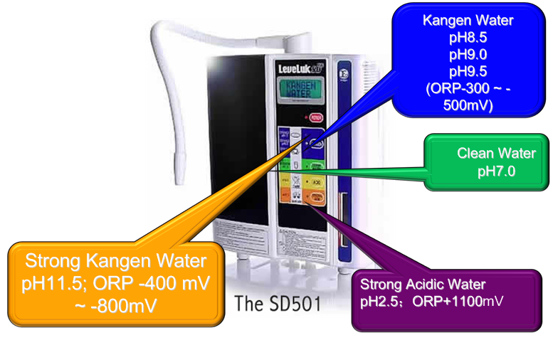
Alkalyze Water

Slide 16
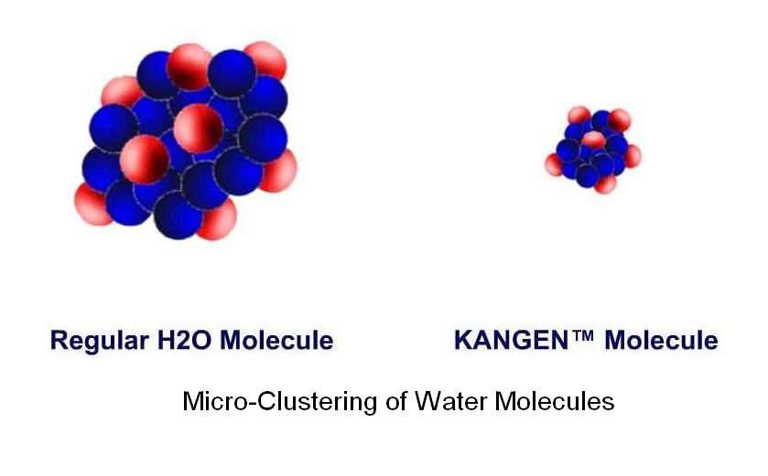
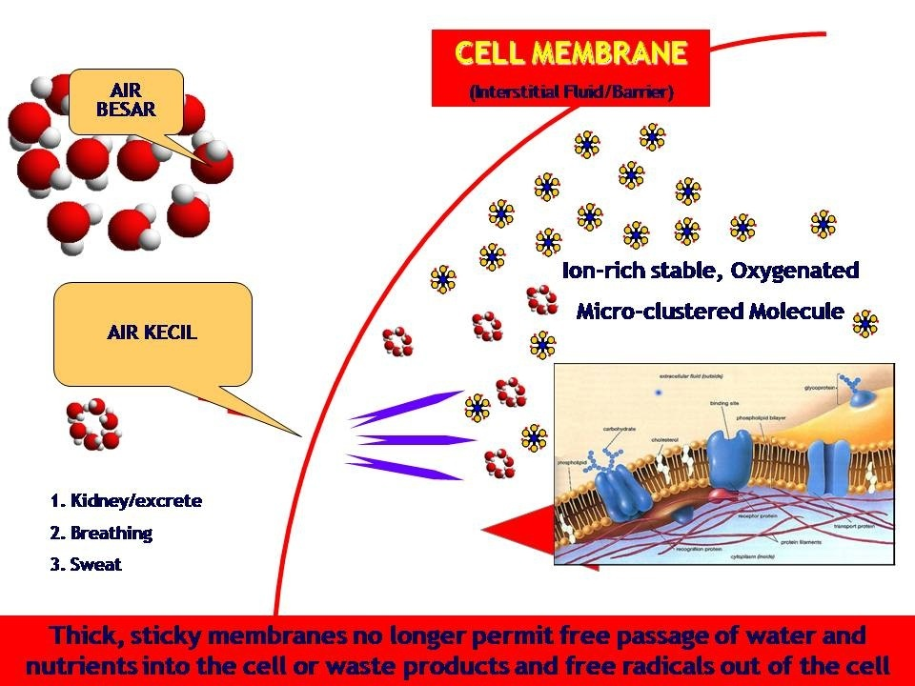
Micro Cluster

Slide 17
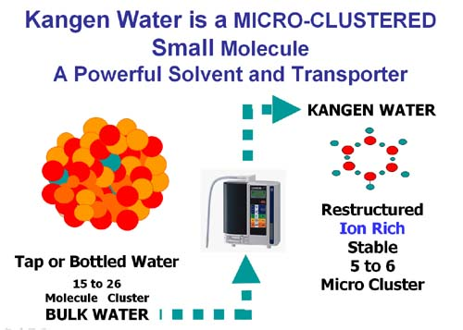

Slide 18
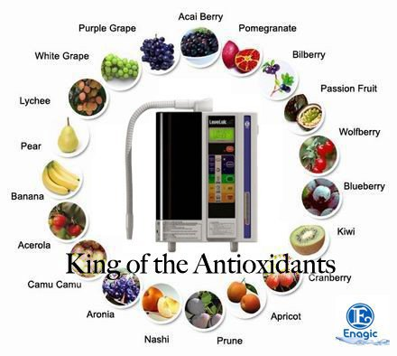
Anti - Oxidant

Slide 19
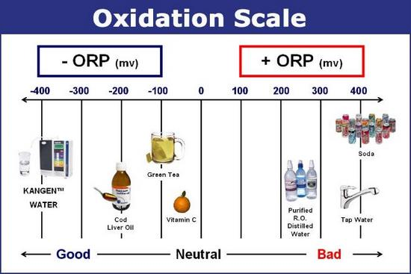

Slide 20
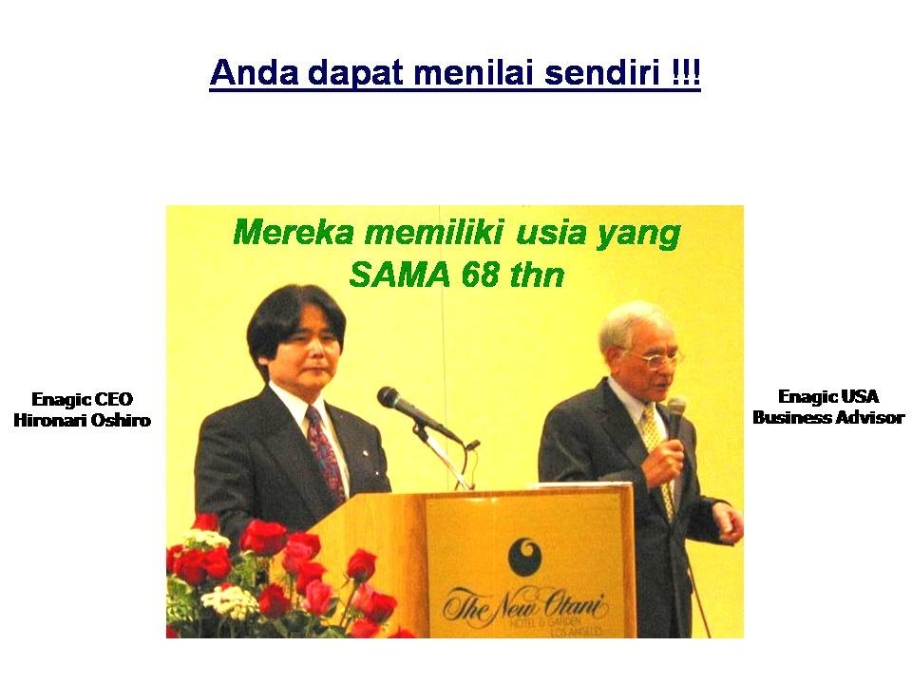

Slide 21
21

Slide 22
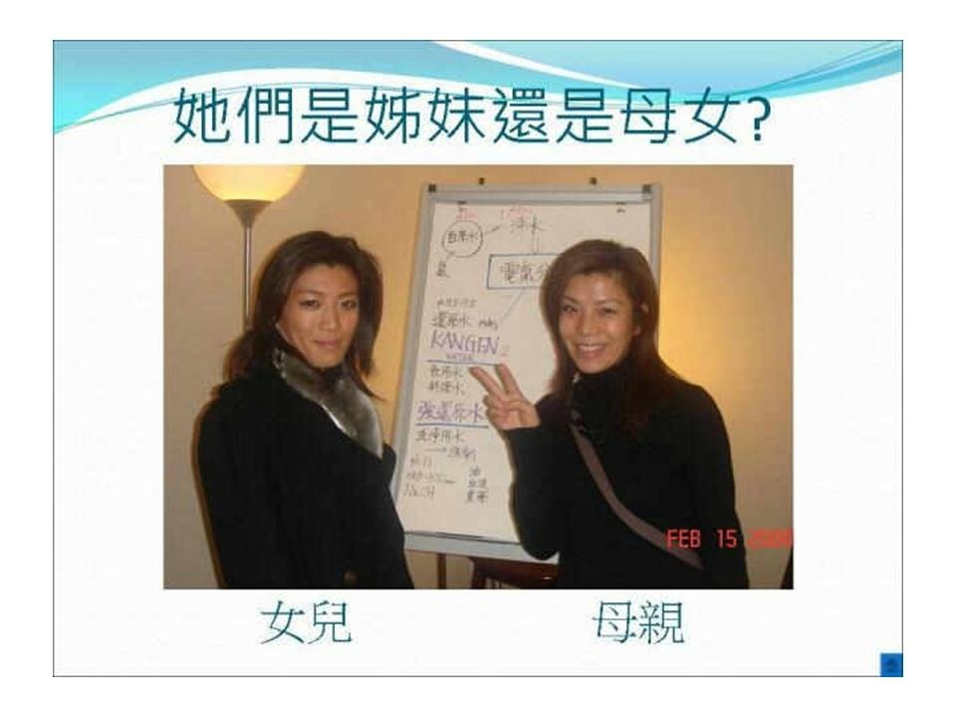
Tebak! mana Ibu dan mana Anak?

Slide 23
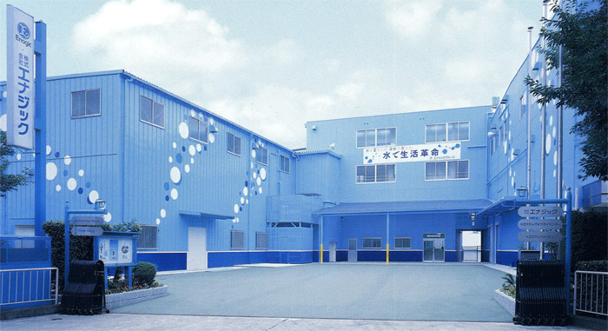
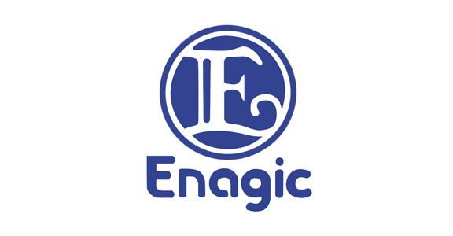
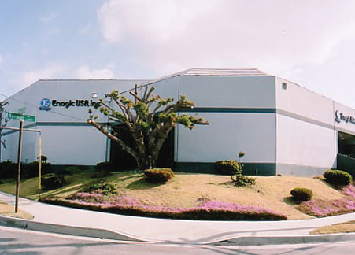
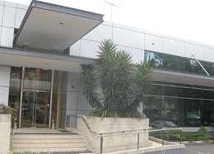
40 Years old Privately Held Company
OEM (Original Equipment Manufactured)
More than $300 Million Annual Revenue
TOP Industrial Leader
20 Branch Office in US, Canada, Mexico,
South East Asia and keep on Expanding
Member of The D.S.A (Direct Selling Association)
Member of the BBB (Better Bureau Business)

Slide 24
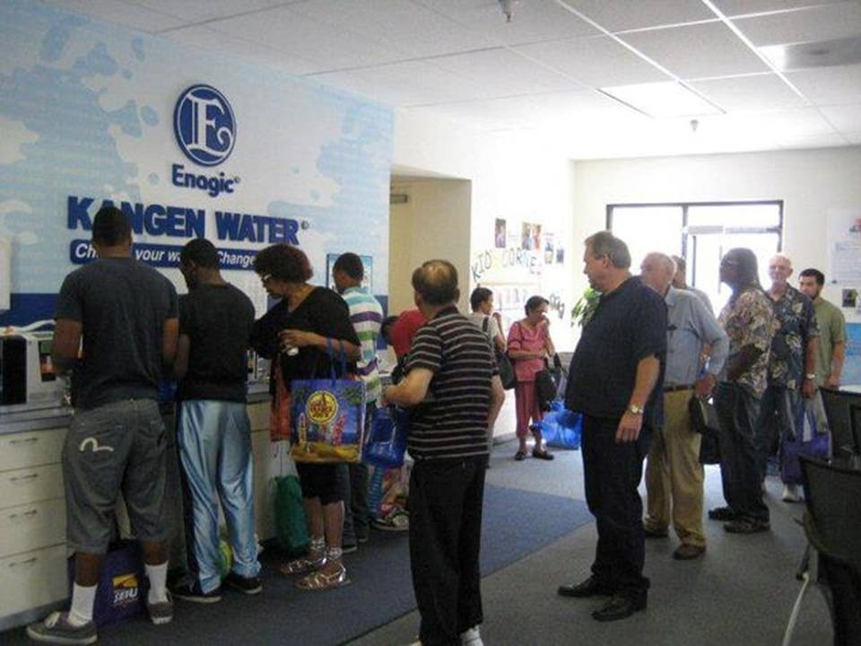
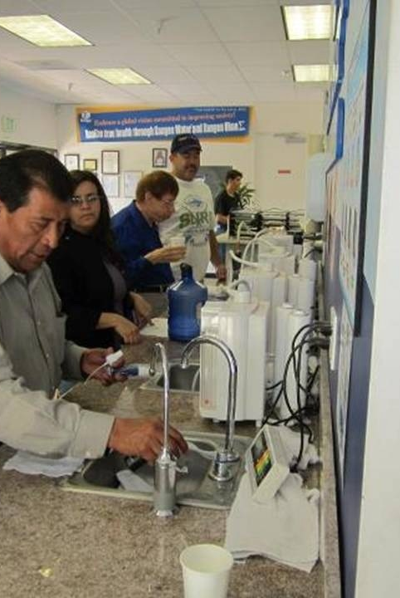
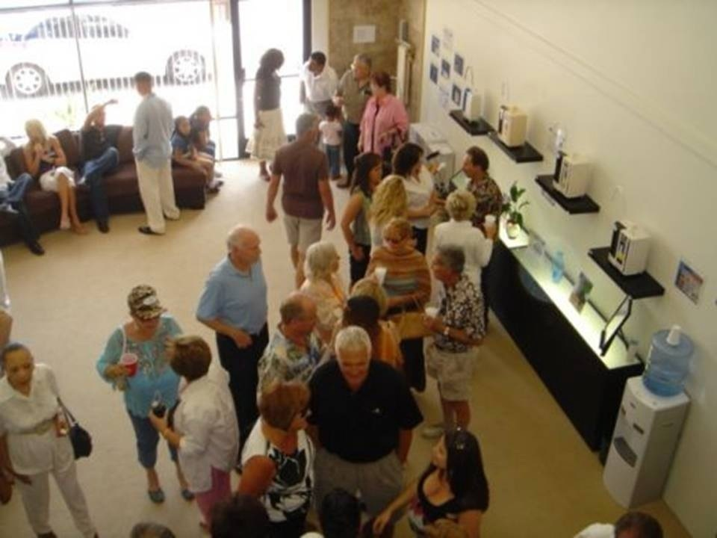

Slide 25

Penghargaan dari USA
Sertifikasi pemerintah USA
melalui WQA

Slide 26
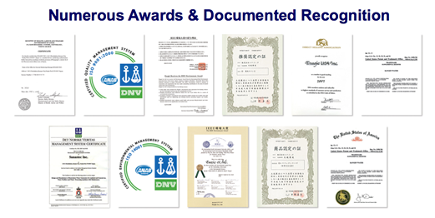
OTHER ACHIEVEMENTS

Slide 27

ENAGIC FLAGSHIP PRODUCT
Make 5 Types of Water
( Alkalyze water, Clean Water, Beauty Water,
Strong Acidic Water, Strong Kangen )
Approved as a Medical Device by
The Japanese Ministry Health & Welfare
7 Platinum Coated Titanium Plates
over $1000)
Industries best Automatic self Cleaning System
Creates Medically approved Grade drinking water
15-20+ Years Product Life Expectancy

Slide 28

28

Slide 29
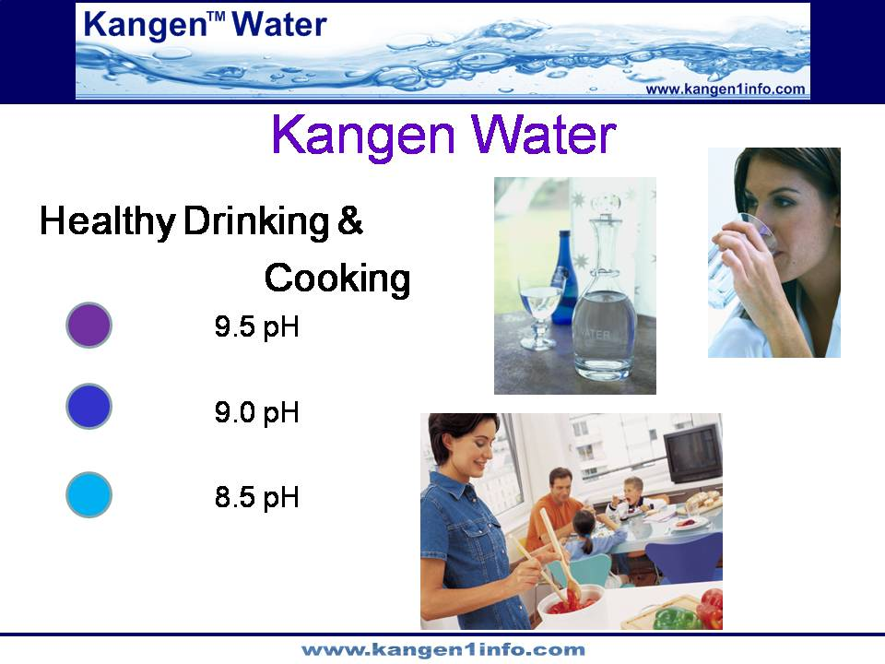
29

Slide 30
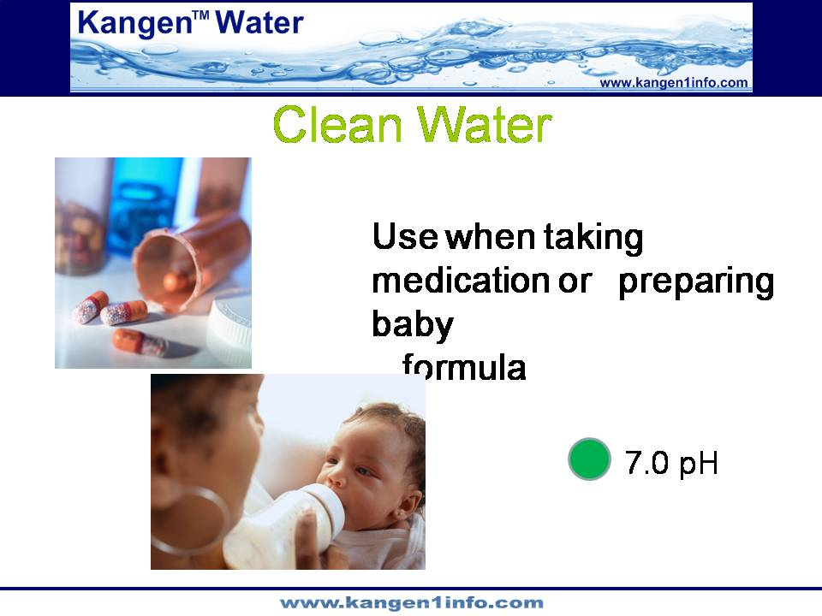
30

Slide 31
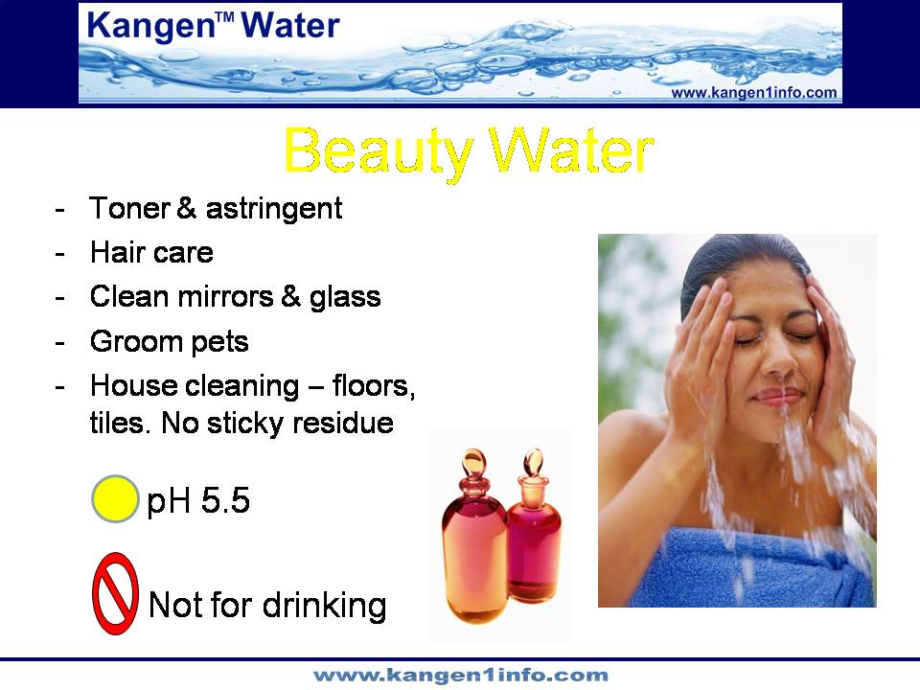
31

Slide 32
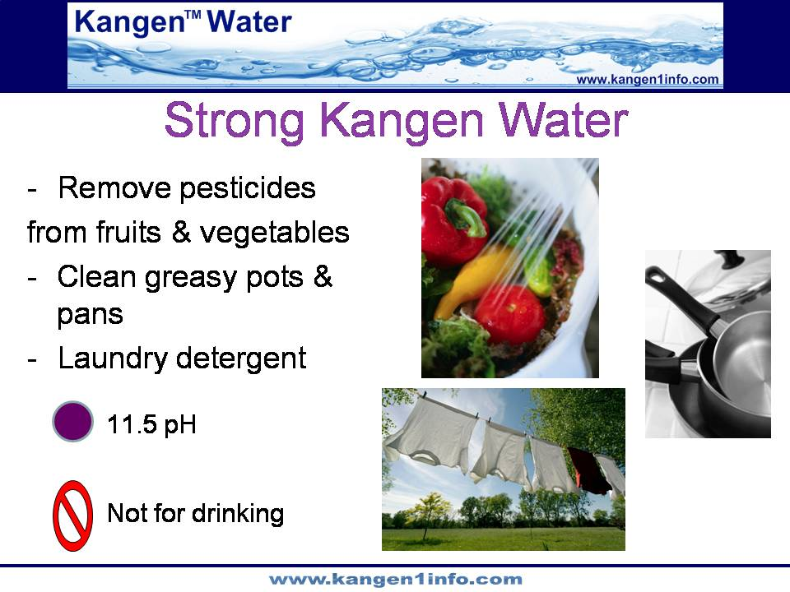
32

Slide 33
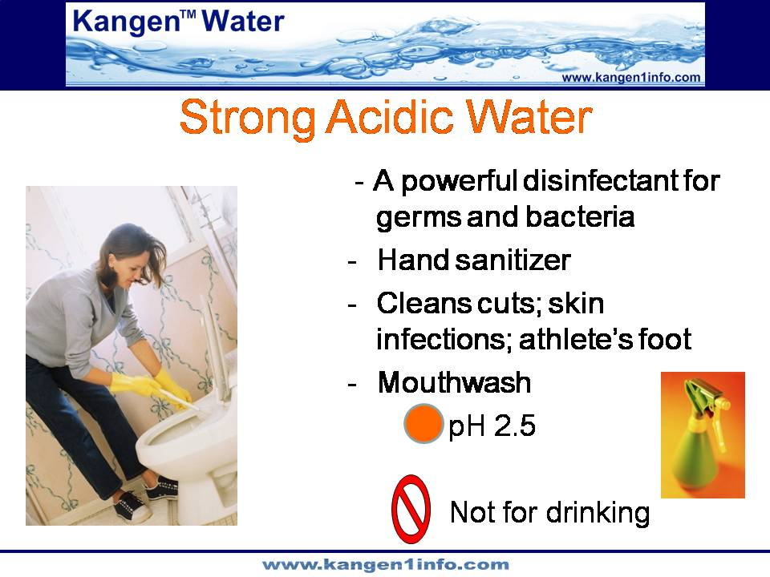
33

Slide 34
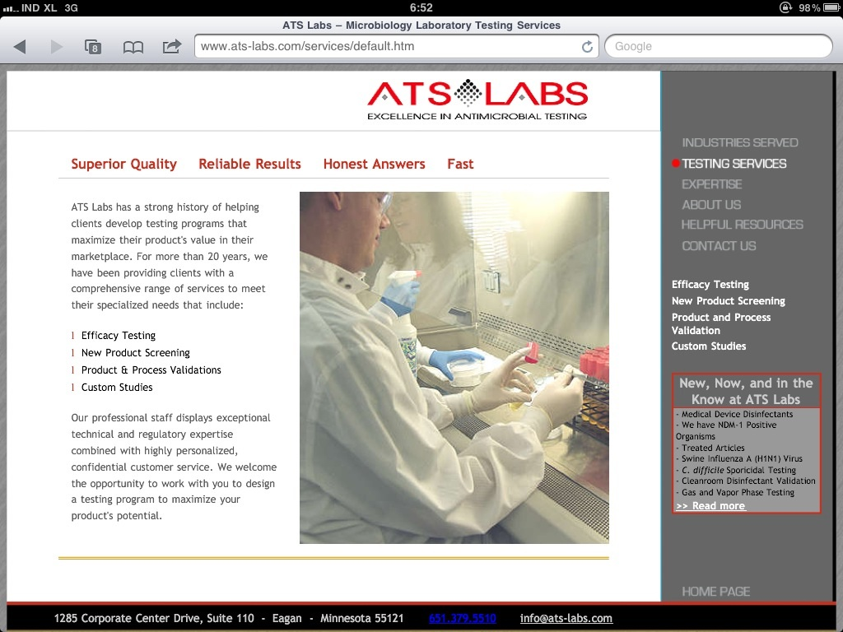
34

Slide 35
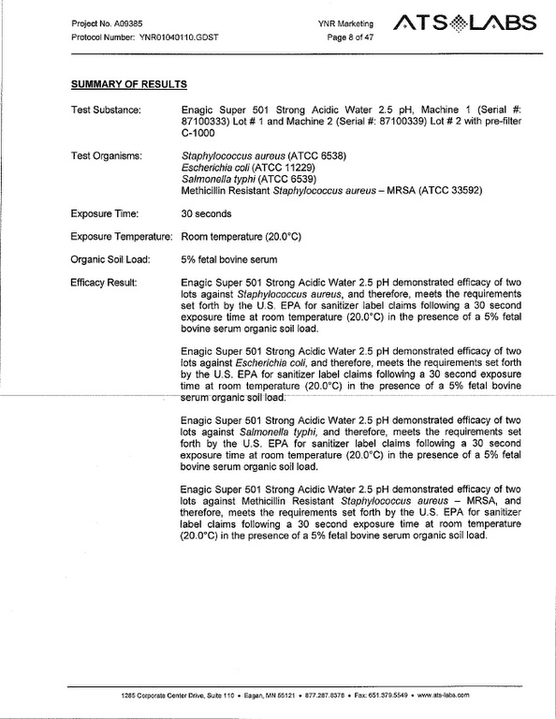
35

Slide 36
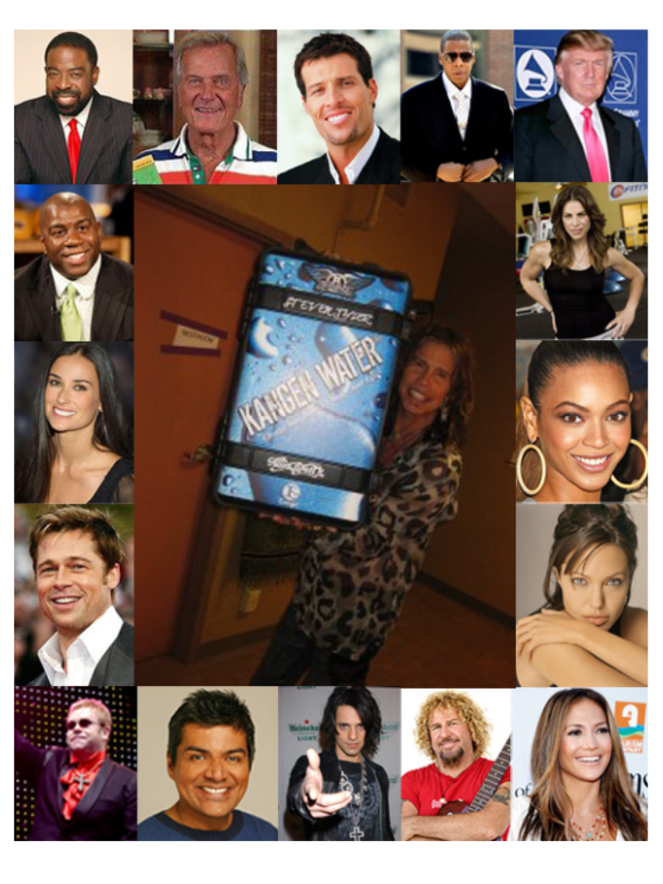
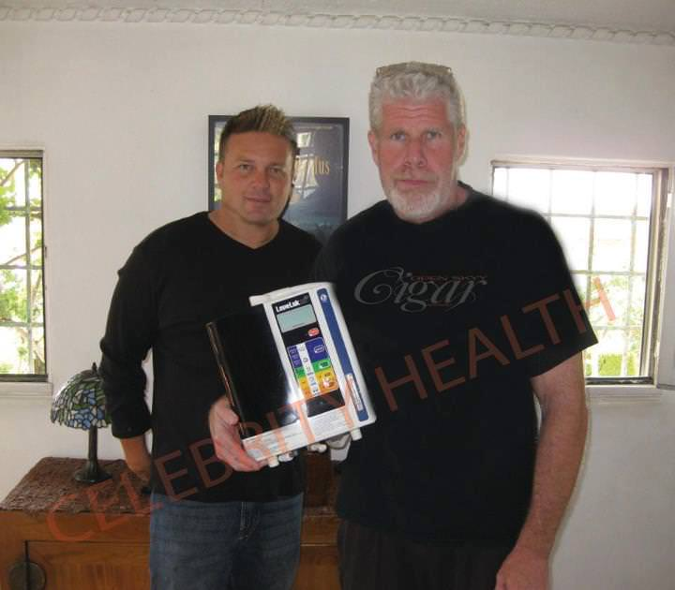
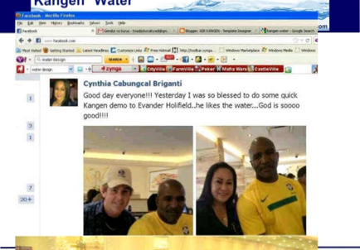
Referensi Kangen Water
Dari Dunia!!!
Jay-Z, Beyonce, Donald Trump, Demi Moore, Aston Kutcher, Steven Tyler (owns 4 machines), Angelina Jolie, Brad Pitt, Janet Jackson, Magic Johnson (owns 8 machines), Jack Nicholson, Steven Seagal, The Obama’s, Chris Daughtry, Sammy Hagar, Bill Gates, Rohan Marley, Jennifer Lopez, Martha Stewart, Carlos Santana, Elton John, Jillian Michaels, George Lopez, UFC FIGHTER Joe “Daddy”Stevenson, Ron Perlman, Chris Angel, John Geraghty (tennis player), Roger Daultry, Cindie Blackman, Bodybuilders Dan Hill & Wade Lightheart, NY Yankees, LA Lakers, 109 y/o Bernando La Poll , New ones added by the day….

Slide 37
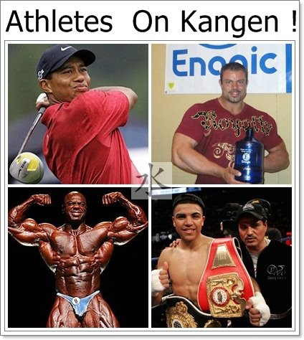
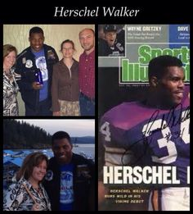

Slide 38
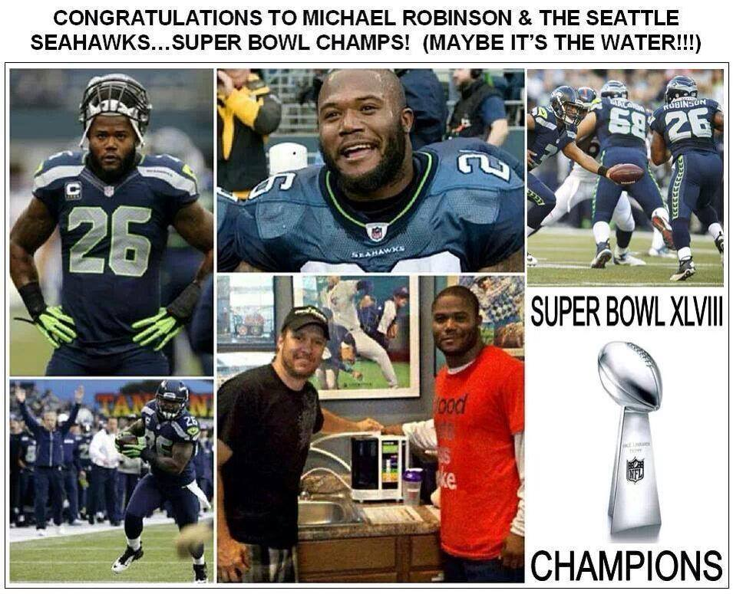

Slide 39
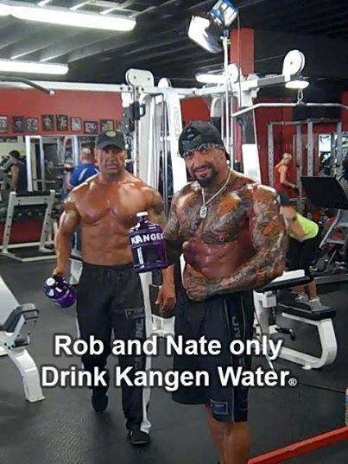
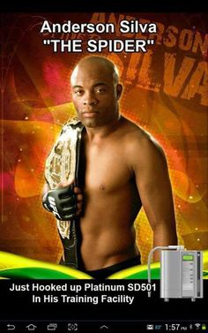

Slide 40




Slide 41


Slide 42


Slide 43


Slide 44




Restaurants & Kangen Water

Slide 45


Dr. Hiromi Shinya,
Pelopor Bedah Colonscopy
(The Shinya Technique)
Telah melakukan lebih dari
370.000 kali pembedahan
Salah satu Dokter paling berpengaruh
di Dunia.
Penulis buku Best Seller
(The Miracle Of Enzyme)
“Kangen Water is considered
the very best drinking Water,
because its incomparable POWER of
HYDRATION, DETOXIFICATION, and ANTI – OXIDATION”
THE ENZYME FACTOR – page 159

Slide 46




Slide 47


Slide 48


Slide 49


Dr.Dave Carpenter
Pakar International
Medical Acupunctur

Slide 50


Slide 51




Slide 52


Slide 53


Apa Kata Mereka tentang
Kangen Water !!!

Slide 54




Apa Kata Mereka tentang
Kangen Water !!!

Slide 55







Slide 56

56

Slide 57

57

Slide 58

58

Slide 59

59

Slide 60

60

Slide 61

61

Slide 62

62

Slide 63

63

Slide 64

Dewan Ketahan Nasional
Sekjen-nya Letnan Jendral Julianto
64

Slide 65

Responnya sangat baik
65

Slide 66

66

Slide 67

67

Slide 68

Mari Kita Buktikan !!!
Dengan Demo Berikut ini

Slide 69


Slide 70





Slide 71



Slide 72

72

Slide 73

Marketing Plan
No Entry Fee
Need A LeveLuk SD 501
YOU
73

Slide 74
Marketing Plan
YOU
1A
Activated By
Direct Sale
$285
Indirect Sales
8 Points
74
Notes:
Paint a picture with sales for them so they can see the potential.

Slide 75
Marketing Plan
YOU
Direct Sale
1A
1A
Activated By
Direct Sale
Activated By
Direct Sale
$285
$285
Indirect Sales
8 Points
8 Points
75
Notes:
First 2 sales you are a 1A and you will get overrides of $285 off of each machine sold in that lane – group or personal.

Slide 76
Marketing Plan
YOU
Direct Sale
Direct Sale
1A
1A
2A
Activated By
Direct Sale
Activated By
Direct Sale
Activated By
Direct Sale
$285
$285
$570
Indirect Sales
7 Points
8 Points
8 Points
76
Notes:
On your 3rd sale you get a pay raise and Enagic will double your commission to $570. You will get overrides of $570 on any machines sold in that lane.

Slide 77
Marketing Plan
YOU
Direct Sale
Direct Sale
1A
1A
2A
Activated By
Direct Sale
Activated By
Direct Sale
Activated By
Direct Sale
$285
$285
$570
10
Group Sales
Indirect Sales
7 Points
8 Points
8 Points
77
Notes:
3 group sales; accumulated to 10 group.

Slide 78
Marketing Plan
YOU
Direct Sale
Direct Sale
Direct Sale
1A
1A
2A
3A
Activated By
Direct Sale
Activated By
Direct Sale
Activated By
Direct Sale
Activated By
Direct Sale 11
$285
$285
$570
$855
10
Group Sales
Indirect Sales
6 Points
7 Points
8 Points
8 Points
78
Notes:
On your next personal sale, you will be a 3A and Enagic will triple your commissions! Let’s say I buy a machine in your 3A lane and I have a Water Party at my house and 10 people buy a machine. You will get 10 checks 8-10 days later for $855 each. You made $8550 and didn’t do anything.

Slide 79
Marketing Plan
YOU
Direct Sale
Direct Sale
Direct Sale
1A
1A
2A
3A
Activated By
Direct Sale
Activated By
Direct Sale
Activated By
Direct Sale
Activated By
Direct Sale 11
$285
$285
$570
$855
10
Group Sales
20
Group Sales
Indirect Sales
6 Points
7 Points
8 Points
8 Points
79
Notes:
With 20 group sales (additional 10 from 2A)

Slide 80
Marketing Plan
YOU
Direct Sale
Direct Sale
Direct Sale
Direct Sale
1A
1A
2A
3A
4A
Activated By
Direct Sale
Activated By
Direct Sale
Activated By
Direct Sale
Activated By
Direct Sale 11
Activated By
Direct Sale 21
$285
$285
$570
$855
$1140
10
Group Sales
20
Group Sales
Indirect Sales
5 Points
6 Points
7 Points
8 Points
8 Points
80
Notes:
On your next personal sale, you become a 4A and your commissions are now $1140. You will get overrides on all the machines sold on that sales team.

Slide 81
Marketing Plan
YOU
Direct Sale
Direct Sale
Direct Sale
Direct Sale
1A
1A
2A
3A
4A
Activated By
Direct Sale
Activated By
Direct Sale
Activated By
Direct Sale
Activated By
Direct Sale 11
Activated By
Direct Sale 21
$285
$285
$570
$855
$1140
10
Group Sales
20
Group Sales
50
Group Sales
Indirect Sales
5 Points
6 Points
7 Points
8 Points
8 Points
81
Notes:
Now you have a total of 50 group sales. It gets exciting here because 50 people have a machine but in reality 300 people could be drinking the water because they are sharing it.

Slide 82
Marketing Plan
YOU
Direct Sale
Direct Sale
Direct Sale
Direct Sale
Direct Sale
1A
1A
2A
3A
4A
5A
Activated By
Direct Sale
Activated By
Direct Sale
Activated By
Direct Sale
Activated By
Direct Sale 11
Activated By
Direct Sale 21
Activated By
Direct Sale 51
$285
$285
$570
$855
$1140
$1425
10
Group Sales
20
Group Sales
50
Group Sales
Indirect Sales
4 Points
5 Points
6 Points
7 Points
8 Points
8 Points
82
Notes:
On your next personal sale, you become a 5A and you get commissions and overrides of $1425

Slide 83
Marketing Plan
YOU
Direct Sale
Direct Sale
Direct Sale
Direct Sale
Direct Sale
1A
1A
2A
3A
4A
5A
Activated By
Direct Sale
Activated By
Direct Sale
Activated By
Direct Sale
Activated By
Direct Sale 11
Activated By
Direct Sale 21
Activated By
Direct Sale 51
$285
$285
$570
$855
$1140
$1425
10
Group Sales
20
Group Sales
50
Group Sales
100
Group Sales
Indirect Sales
4 Points
5 Points
6 Points
7 Points
8 Points
8 Points
83
Notes:
All you need is 100 group sales and you reach the top of the company.

Slide 84
Marketing Plan
YOU
Direct Sale
Direct Sale
Direct Sale
Direct Sale
Direct Sale
Direct Sale
1A
1A
2A
3A
4A
5A
6A
Activated By
Direct Sale
Activated By
Direct Sale
Activated By
Direct Sale
Activated By
Direct Sale 11
Activated By
Direct Sale 21
Activated By
Direct Sale 51
Activated By
Direct Sale 101
$285
$285
$570
$855
$1140
$1425
$1710
10
Group Sales
20
Group Sales
50
Group Sales
100
Group Sales
Indirect Sales
3 Points
4 Points
5 Points
6 Points
7 Points
8 Points
8 Points
84
Notes:
On your next personal sale, you are a 6A and your commissions will be $1710.

Slide 85
Once You Hit 6A
6A
6A
6A
6A
6A
6A
6A
6A
YOU
$1710
$1710
$1710
$1710
$1710
$1710
$1710
$1710
$200 Education Bonus
85
Notes:
Every personal sale after that will be on your 6A team & you will receive commissions & overrides of $1710. Plus, you will get $200 on every machine after your 8 points.

Slide 86

What the Top Earners Are Doing
Share the Kangen Water
Educate & Inform
Live Demonstration
Follow-Up
Duplicate
Simplicity is the Key

Slide 87
Hubungi Pengundang Anda untuk Informasi Lebih Lanjut
TERIMA KASIH

